Slide 1


Engineering With Python Internship Course Project Presentation

Slide 2
Student Report Card Generation and Sender(SRCGS)
Deepak V
deepak474700@gmail.com

Slide 3





Why SRCGS? Can Whatsapp or mail services be a solution
WhatsApp and mail services like(Gmail ,Yahoo ,Outlook ..) of course it’s a familiar application for everyone for sharing messages.
To send marks in a fixed format to others by changing marks is often a stressful format and time consuming.
That’s why SRCGS software comes to play.

Slide 4


What is SRCGS?
Student Report Card Generator and Sender (SRCGS) System is a software aims to generate report card of students including the total and percentage of each student’s academic performance in each examination using basic data about School name, Academic year etc..
The mark sheet uploaded as .csv file by the teachers and sends this report card using given mail id on .csv file to the concerned parent or student.
Simply it’s a 2-in-1 process report card generation and sending on a click.
Effective in time management and human effort.

Slide 5
What all we need in SRCGS
SRCGS need only these parameters
School Name
Academic Year
Exam name
Number of Exams
Marks per subject
Teacher Name
Teacher Email ID(*Only Gmail)
Teacher Email ID Password
Marsheet in(.csv format)

Slide 6
Advantages of SRCGS
Advantages
Time Efficient
Simple GUI
Stress Free
Privacy & Moral aspect

Slide 7
Advantages of SRCGS
Time Efficient | SRCGS is time efficient only few data is needed the report card will generate and send automatically to given email.
Simple GUI | SRCGS having simple Graphical User Interface anyone can understand.
Stress free | SRCGS reduces manual effort of human for sending the report card individually.
Privacy & Moral Aspect | Each student getting individual report card personally without knowing others. This prevent abashment among students and mental stress.

Slide 8
Process of SRCGS
Fill the parameters and upload marksheet
Cilck SUBMIT button
Email gets received to intended receiver

Slide 9

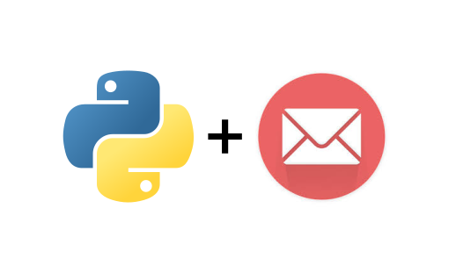

Python Modules Used
HTML Viewer
SMTP Library

Slide 10
Hardware and Software Requirements
SOFTWARE REQUIREMENTS:
Software Language: Python
Software Language Modules: Tkinter, Pandas, smtplib, tkhtmlview
IDE: IDLE Python (3.8 64-bit)
OS: Windows 7 Ultimate Service Pack 3/8.1/10
HARDWARE REQUIREMENTS:
Processor: Intel® Pentium / AMD FX (Dual Core) above
RAM: 1 GB and above
Hard Disk: 2 GB and above
Display: LED 15.6” @ 1024 x 786 above
Media: USB/DVD/Internet
Internet: Any ISP providing 1Mbps (At least) 5Mbps and above (Recommended)

Slide 11
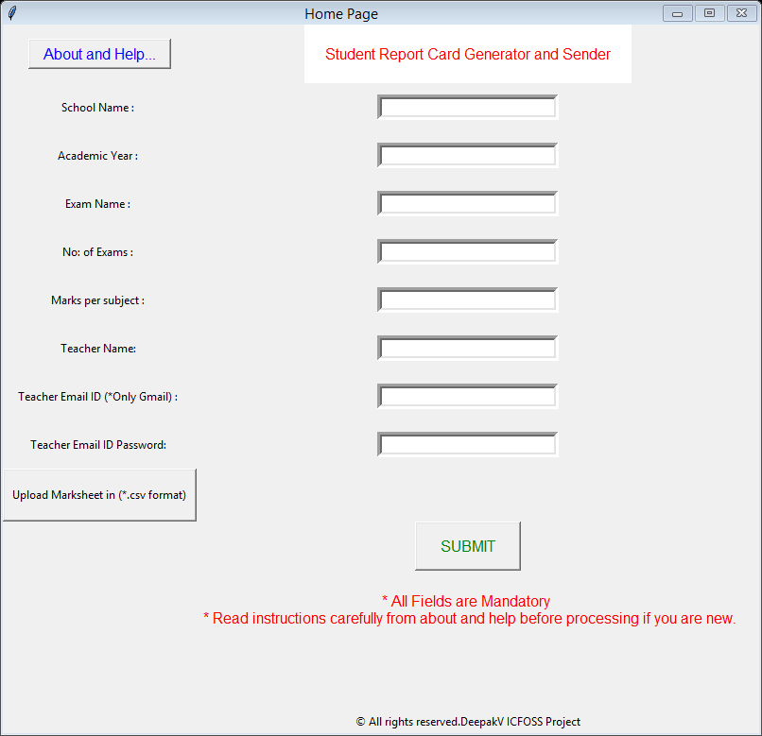
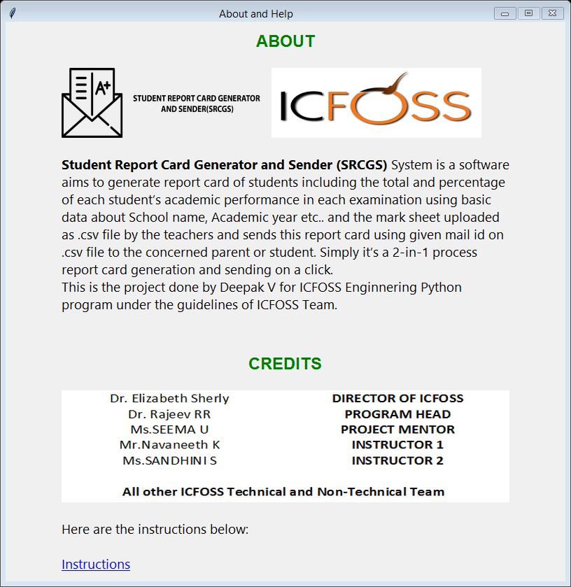
Screenshots

Slide 12
Future Enhancements
What kind of error displaying can be implemented
Success and failed cases of sending report cards
if success=> success count
else failed email list
Different Email services can be implemented
.csv file can be retrieved from clouds like drive...
Internet status alert
Live Status of processes can be implemented
Grade System implementation
GUI can be modified
other platform implementation like android,mac,Linux...
And More innovations.

